Slide 1


Section 4.1 The Mean Value Theorem

Slide 2
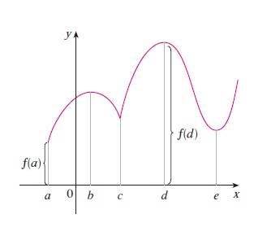

Slide 3
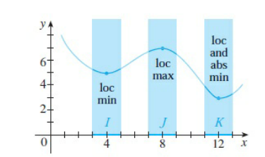


Slide 4
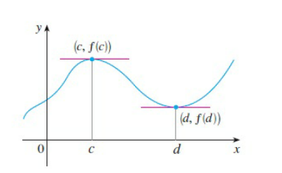




Slide 5



Slide 6



Slide 7



Slide 8


Slide 9

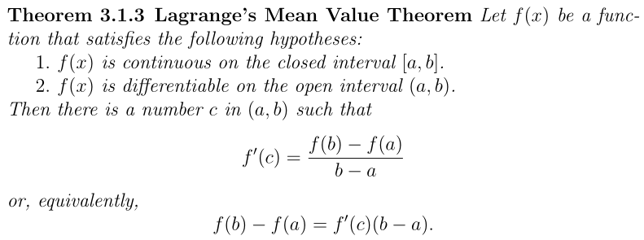

Slide 10
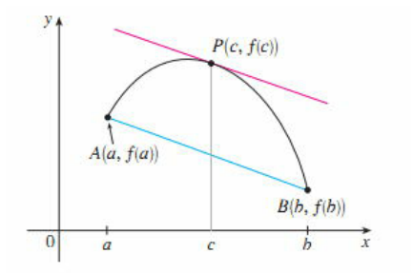
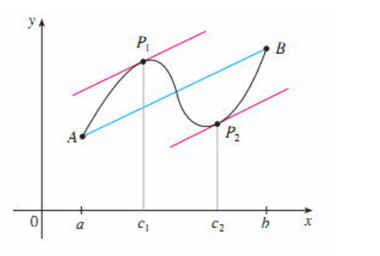

Slide 11



Slide 12



Slide 13

Homework 1

Slide 14

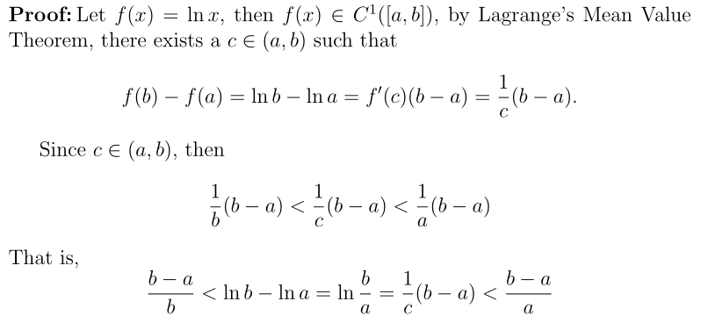

Slide 15


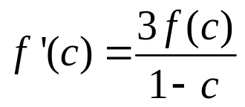
Homework 2
Example 3.1.8: If f(x) is continuous on [0,1],and differentiable on (0, 1)
f(0)=0, show that there exists a c ∈(0, 1) , such that

Slide 16
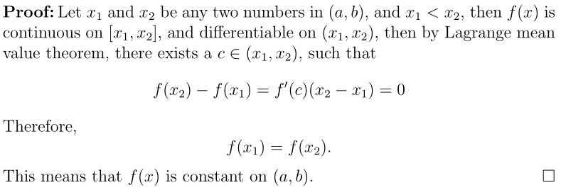

Slide 17
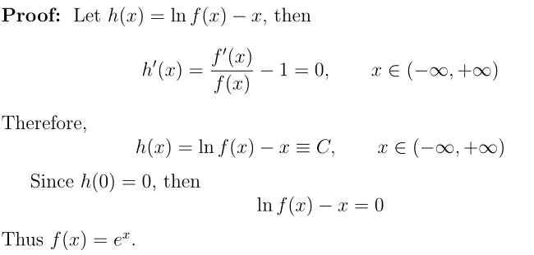

Slide 18




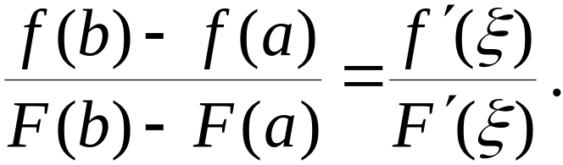





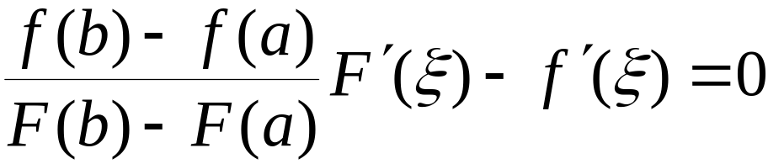

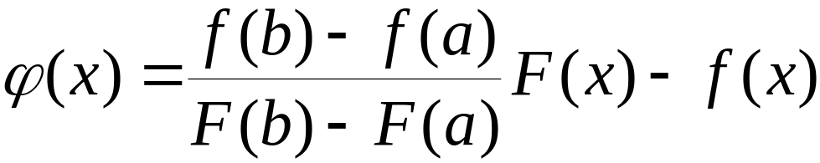
Theorem 3.1.4、Cauchy’s Mean Value Theorem
and
satisfy :
(1) Both of them are continuous on [a, b]
(2) Both of them are differentiable on (a, b)
(3)
when x∈ (a, b)
Then there exists at least a
s.t.
Analysis:
We want to prove

Slide 19


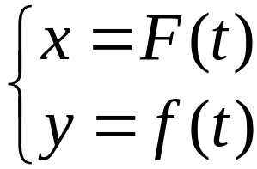

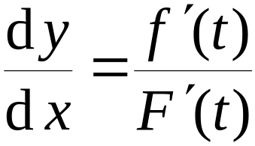






Geometric interpretation:
The slope of the secant
The slope of the tangent
Note:

Slide 20




Example 3.1.12. Suppose that
Show that there exists at least a
such that
Example 3.1.13.
Show that there exists at least a
such that

Slide 21


Summary
Fermat’s Lemma
Lagrange’s Mean Value Theorem
Rolle’s Theorem
Cauchy’s Mean Value Theorem

Slide 22




Exercise:
1. Suppose that
Show that there exists at least a
such that
2. Suppose that
Show that there exists at least a
such that

